Slide 1


TAXI APPLICATION DATABASE
Shristi Duwadi (Student ID - NF1000995)

Slide 2
Introduction
Database creation
11 interrelated tables
Data manipulation
Inserting data
Data retrieval
Used Python to generate fake data
Updating data
Deleting data
Aggregation
Subquery
CTE, multiple CTE’s
View

Slide 3
Database creation
Order | Table name | Description
1 | vehicle | Information about each vehicle
2 | status_person | Status of a user: active, inactive or suspended
3 | dni_type | Identity document type: passport, ID, driver’s license
4 | account_user | Account user information
5 | score | Drivers’ and customers’ score of each trip
6 | payment_method | Payment method choices
7 | location | Route of each trip
8 | payment | Payment information of each trip
9 | driver | Driver information
10 | customer | Customer information
11 | trip_history | Trip history

Slide 4
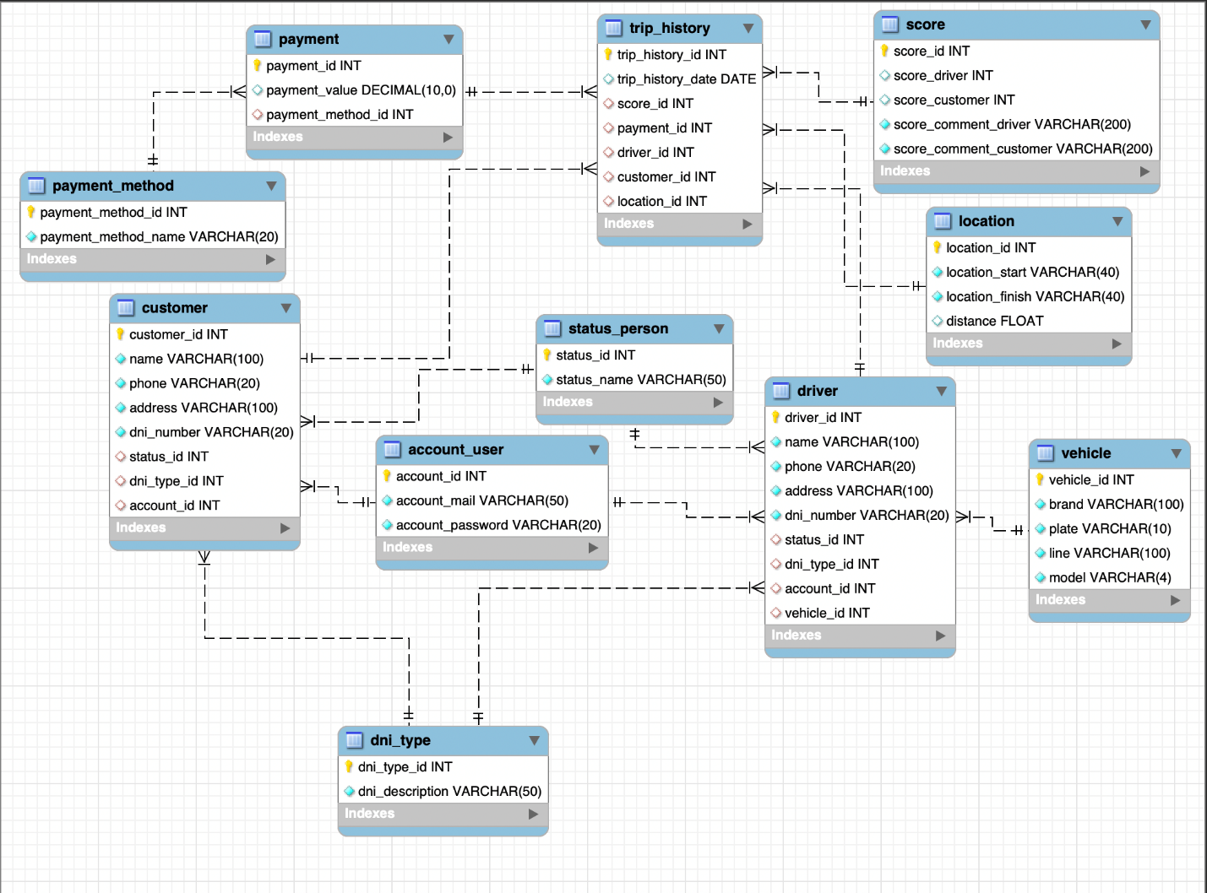
Database creation
Order | Table name
1 | vehicle
2 | status_person
3 | dni_type
4 | account_user
5 | score
6 | payment_method
7 | location
8 | payment
9 | driver
10 | customer
11 | trip_history

Slide 5
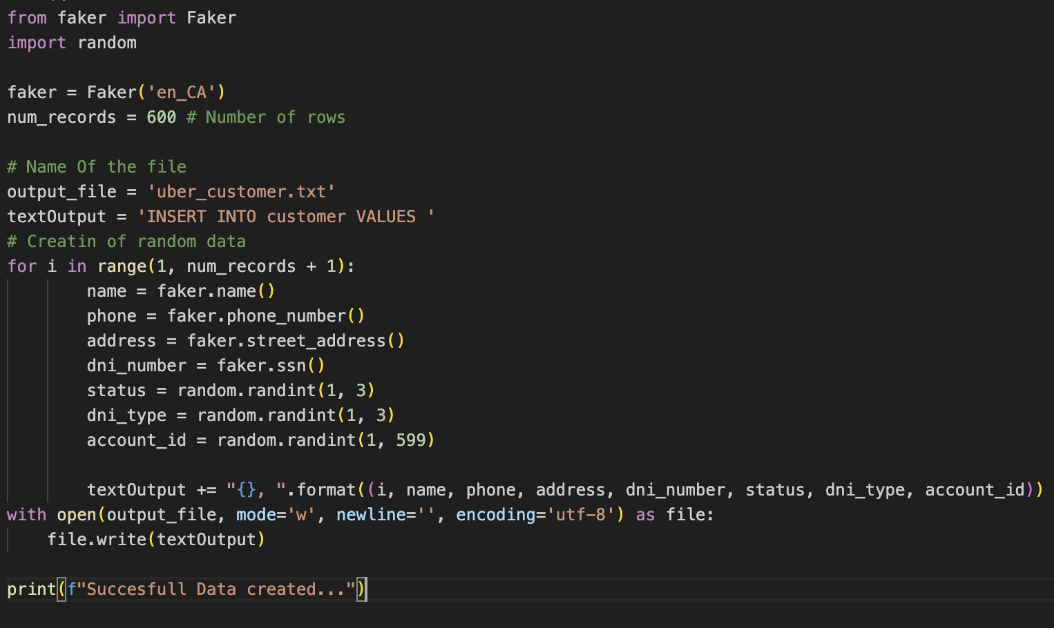
Data creation on Python
Attribute | Number of Registers
customers drivers vehicles location payment score Trip_history user | 600 400 400 2000 2000 2000 2000 1000

Slide 6

Data manipulation-INSERT

Slide 7
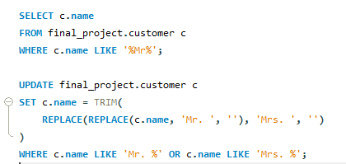
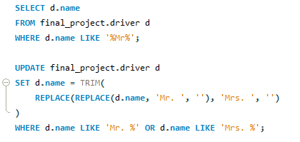
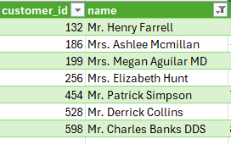
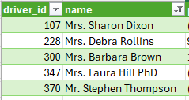
Data manipulation-UPDATE

Slide 8
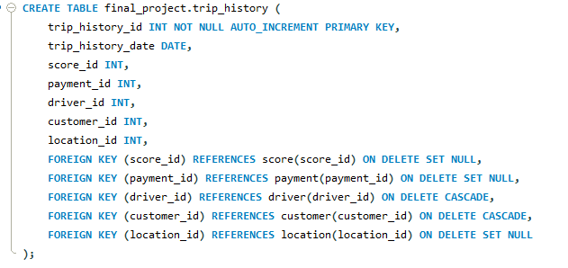
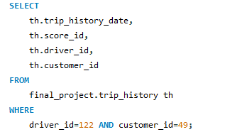



Data manipulation-DELETE

Slide 9
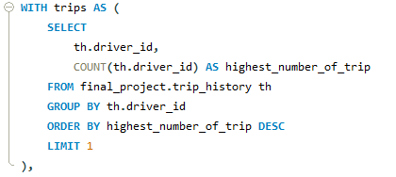
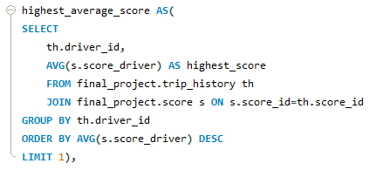
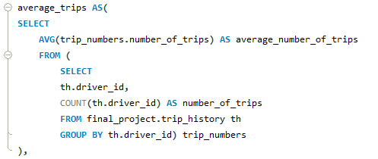
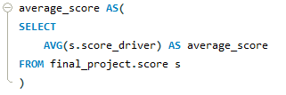
Data Retrieval-driver
Top 10 drivers with the highest amount of payment, their number of trips, and average score compared to the highest number of trips, average number of trips, highest average score, and average score in general.

Slide 10
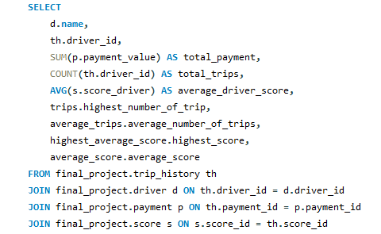
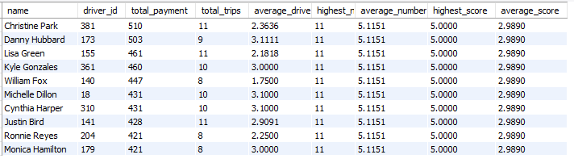
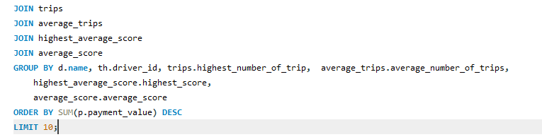
Data Retrieval-driver
Top 10 drivers with the highest amount of payment, their number of trips, and average score compared to the highest number of trips, average number of trips, highest average score, and average score in general.

Slide 11
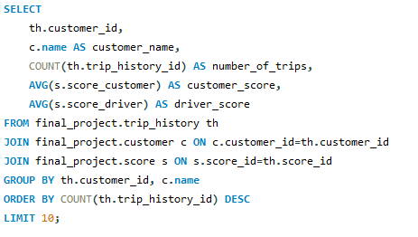
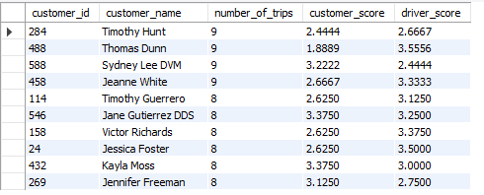
Data Retrieval-customer
To find out the loyal customers, we retrieved the top 10 customers with the highest number of trips, and we included the average score given to drivers and received from the drivers as well.

Slide 12
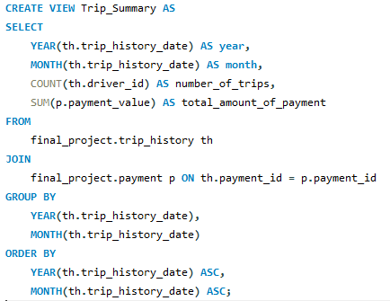
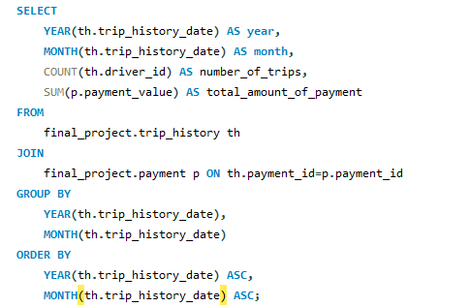
Data Retrieval-trips
Number of trips and the total amount of payments made by month

Slide 13
Conclusion
Comprehensive and Well-Structured Design:
11 interconnected tables.
Efficient management of core data entities, such as customers, drivers, vehicles, payments, and trip history.
Data Integrity and Normalization Third Normal Form (3NF) Compliance:
Ensures data integrity, reduces redundancy, and maintains consistency.
Implementation of SQL Views: Facilitates reusable queries, reducing repetitive query writing.
Insights from Views: Ability to track monthly trip activity, payment trends, and driver performance.

